Slide 1

Knob and Switch Computer
Bevilacqua Joey
Brunner Nicola
Notes:
Nicola:
- INTRODUCTION -
Happy to present you our pf1 project!
Based on Knob & switch computer we utilized in first lessons of CA.

Slide 2
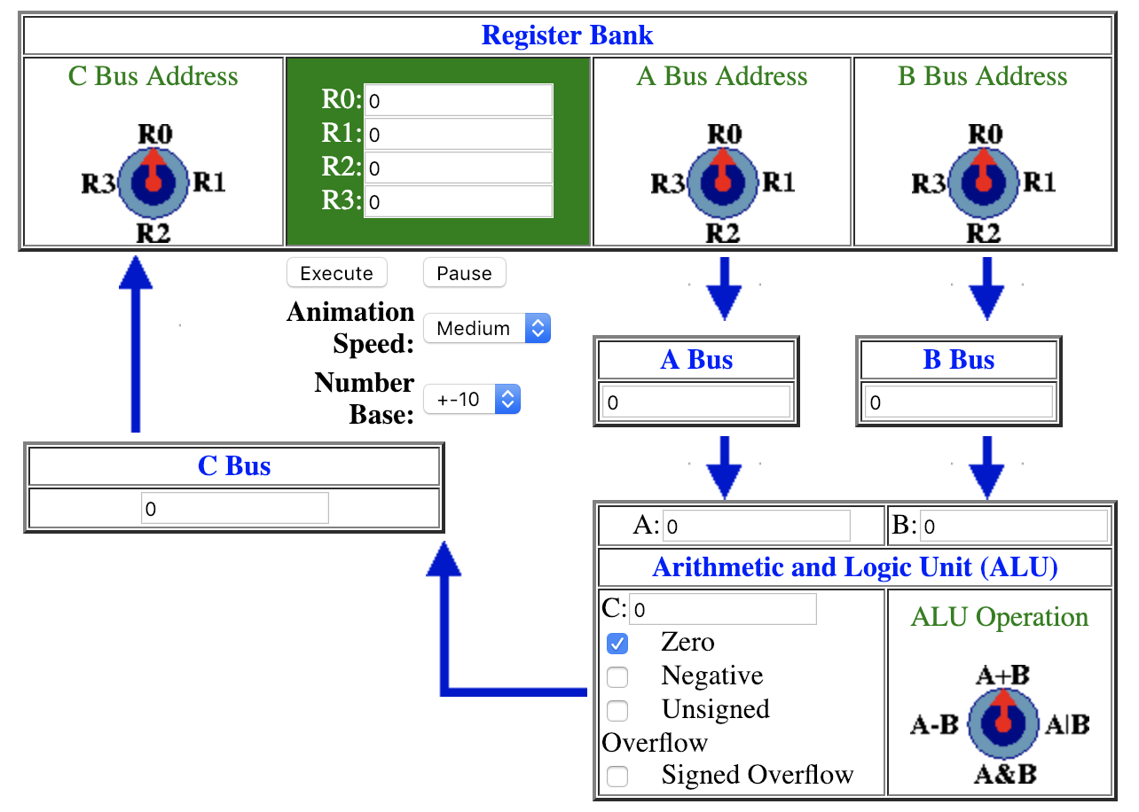
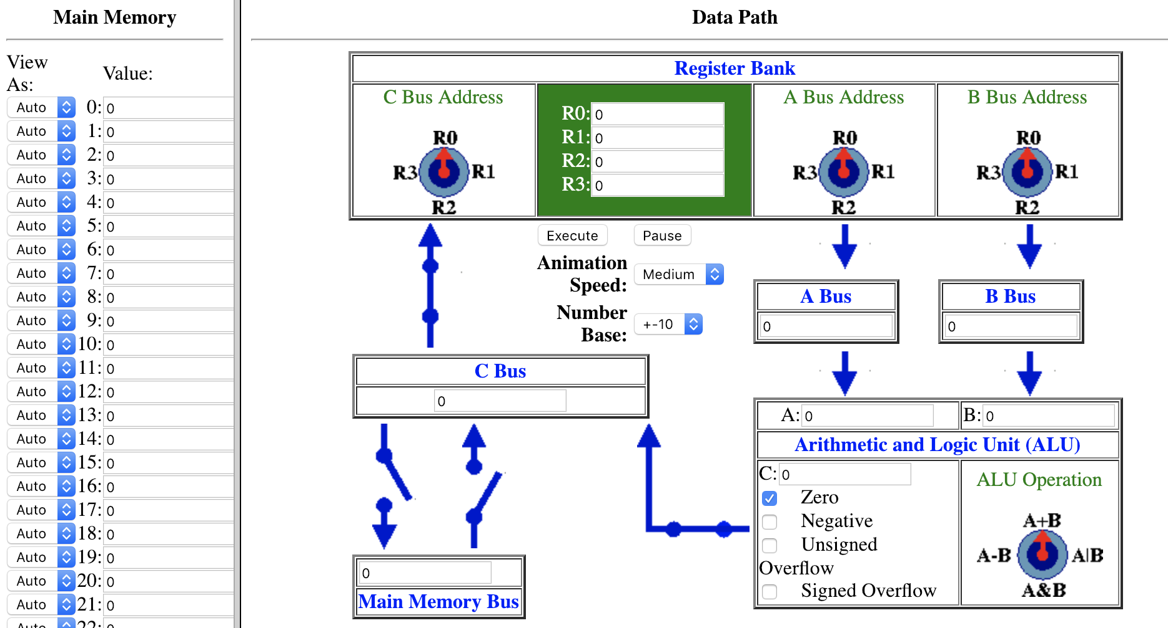
Notes:
Nicola:
- VERSION 1 -
as you all know you see here the first version of the Knob & switch computer we utilized in first lessons of CA
You see the register Bank, A and B bus selector, A and B Bus, the ALU, the C Bus, and the C-Bus – register selector.

Slide 3
Notes:
Nicola:
- VERSION 2 -
Here we see the second version with the memory and the switches.

Slide 4

My name is Rackettino
Notes:
Nicola:
- VERSION 3 -
And here we have the third version:
E la terza versione: more beautiful and simple.
OUR VERSION
[ you can see how happy rackettino is to use the K&S ]

Slide 5
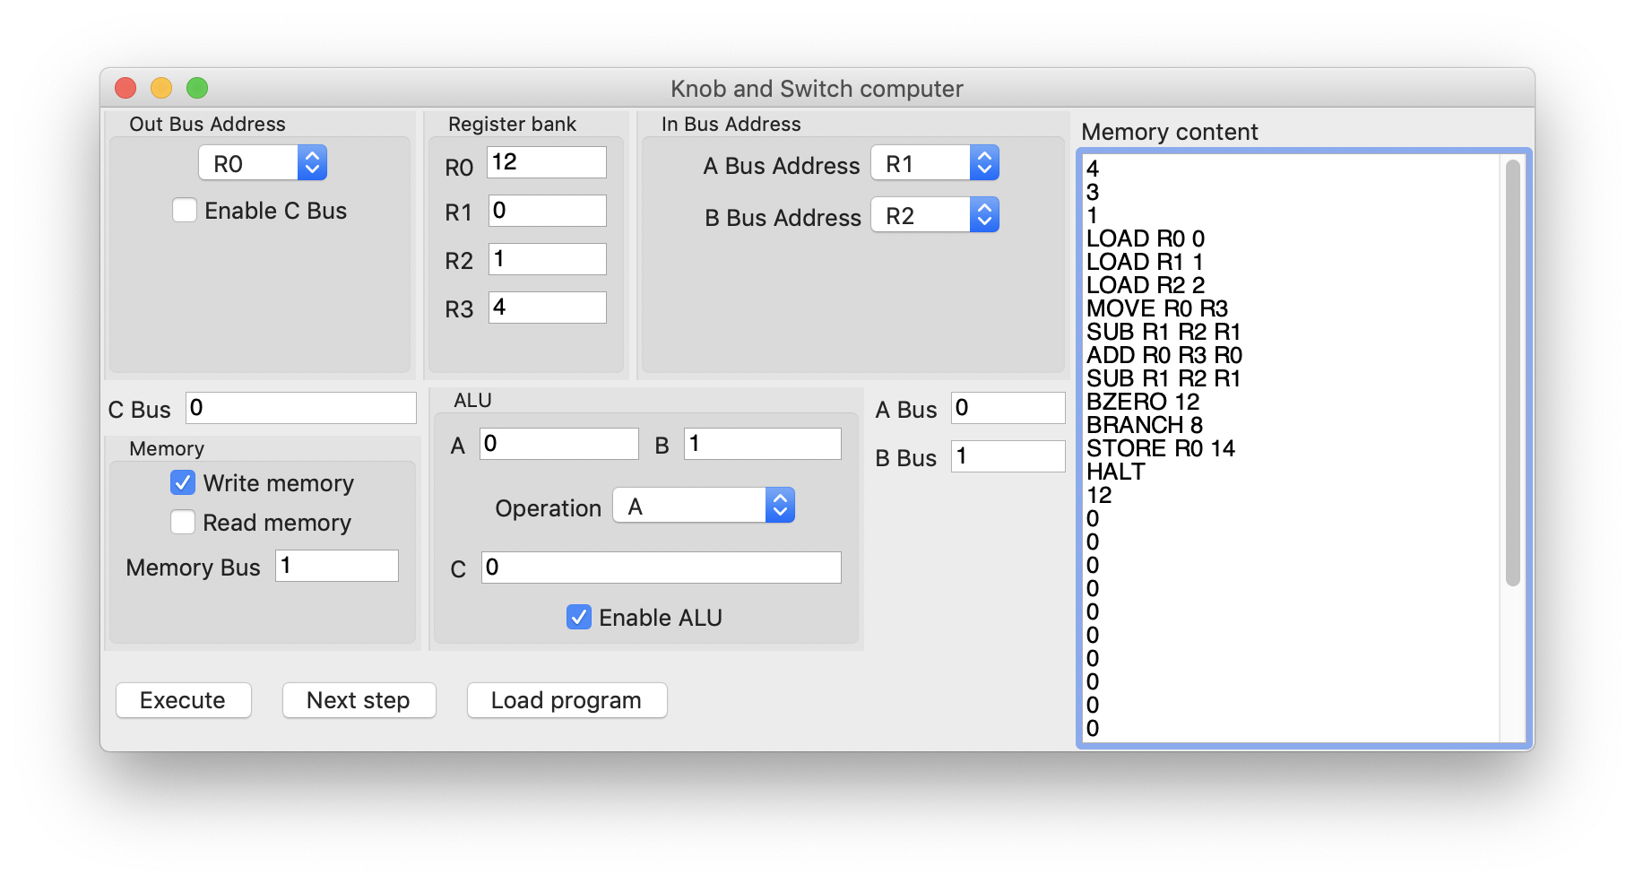
Notes:
Nicola:
- DATAPATH -
Register bank: 4 registers to store numbers
Input (from register) bus address
Input bus
ALU (with his 4 operations)
Memory bus
Output C Bus

Slide 6

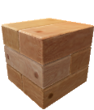

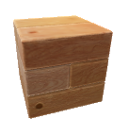



Program architecture
Notes:
Nicola:
- HOW DOES IT WORK -
In this accurate representation of our program you can see how everything more or less works…
For more accurate information's I give now the floor to Joey.

Slide 7
Executor
Program architecture
View
Controller
Notes:
Joey:
Il programma e’ diviso in 3 parti

Slide 8
Executor
1. Initialization

Slide 9
Executor
2. GUI initialization
View
Notes:
L’executor si occupa di ”attivare l’interfaccia grafica”

Slide 10
3. View uses logic from the controller
View
Controller
Notes:
Joey: L’interfaccia grafica interagisce con il controller
per le operazioni “logiche”

Slide 11


Project management
Staging
Master
Testing
Notes:
Joey: come abbiamo gestito il progetto
La repository di git ha 2 branch:
Staging e master: I commit vengono fatti su staging,
e immediatamente testati. In seguito, dopo aver verificato
il corretto funzionamento del programma, venivano inviati a
Master che veniva periodicamente sincronizzato con la repository
per la submission.

Slide 12
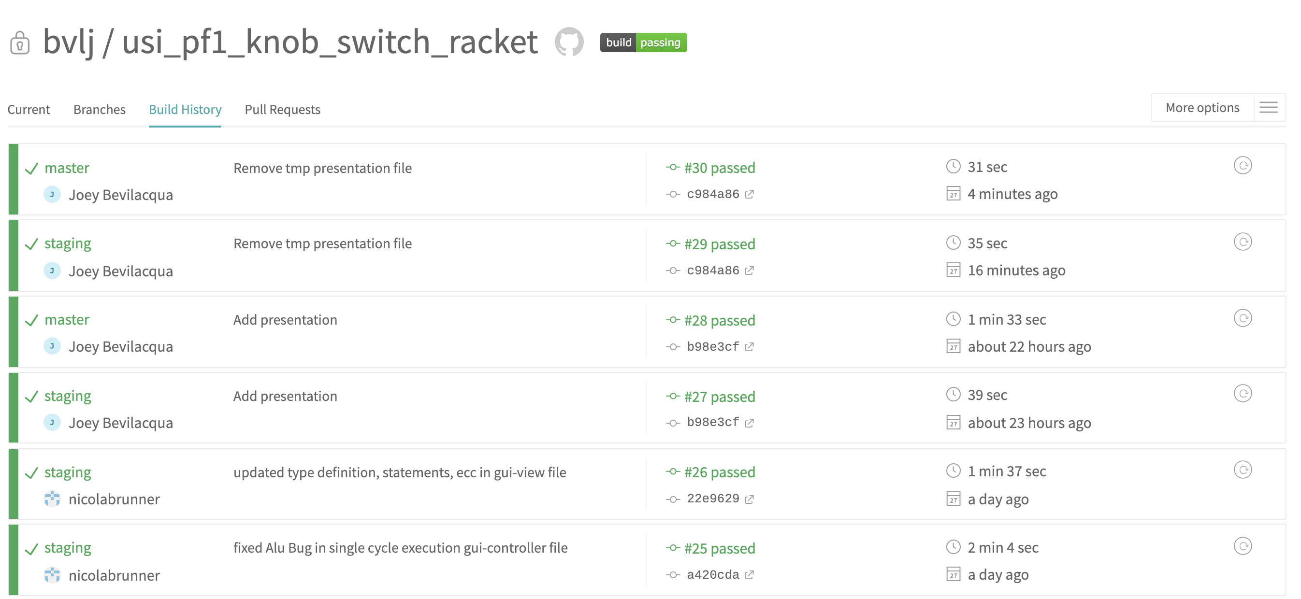
Testing
Notes:
Joey: testing
Ad ogni commit inviato un sistema automatico (Travis CI)
esegue una serie di test per assicurare il corretto funzionamento
del codice.

Slide 13

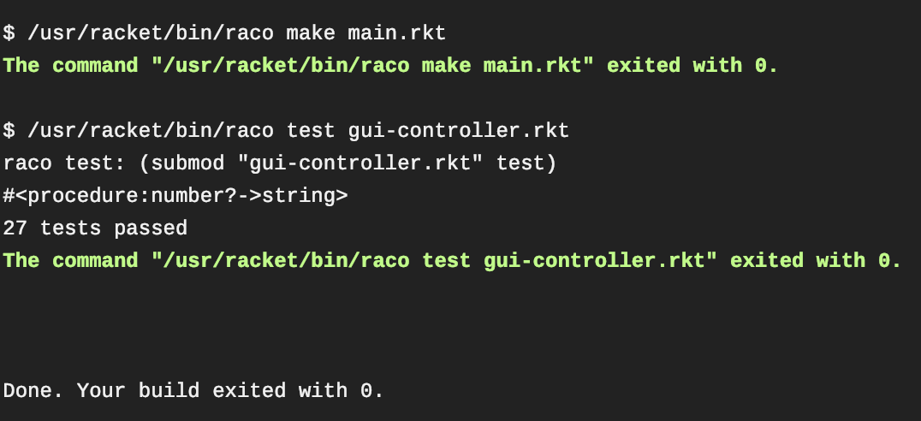
Testing
Automatic compilation and check-expect execution
Notes:
Il test consiste in due parti: compilazione ed esecuzione di
tutti i check-expect per assicurare che le modifiche fatte
Non abbiano effetti collaterali indesiderati anche gravi.
Quando rakettino vede 27 tests passed e’ felice

Slide 14
Notes:
Nicola:
- DEMO -
Now we make a Demo were you can see
How to calculate 1+2=3 (It means in a single cycle how to add for example R0 + R2 and save it in R2)
How to load a program: in this case multiplication of 4*3 which saves the result in the memory, we find also branches, ecc…

Slide 15
THANK YOU FOR YOUR ATTENTION

